Slide 1
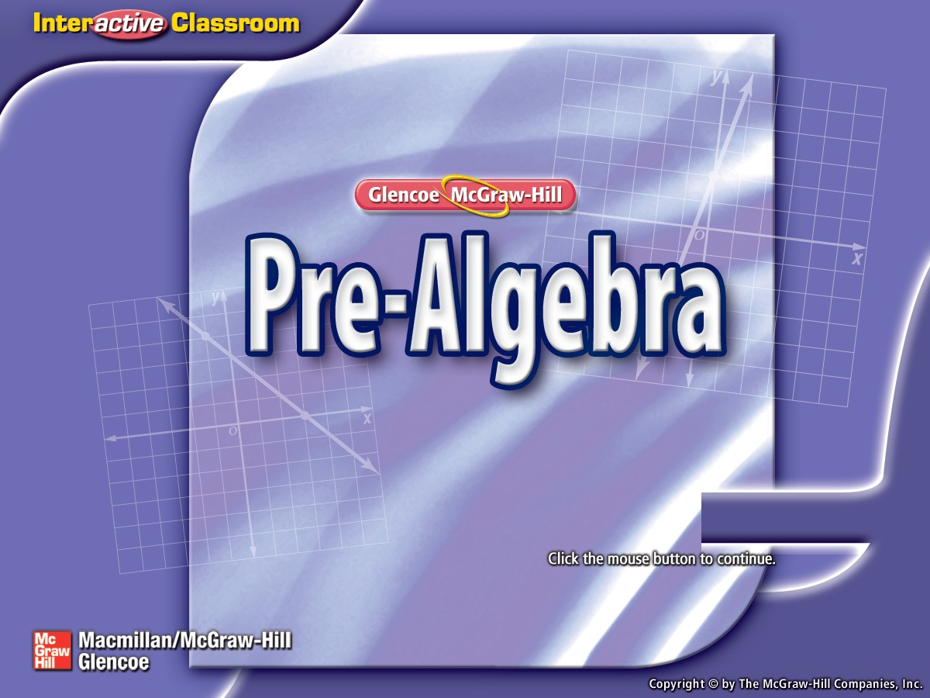


Splash Screen

Slide 2
Lesson Menu
Five-Minute Check (over Lesson 3–1)
Then/Now
New Vocabulary
Example 1: Write Mixed Numbers and Integers as Fractions
Example 2: Real-World Example: Write Terminating Decimals as Fractions
Example 3: Write Repeating Decimals as Fractions
Concept Summary: Rational Numbers
Example 4: Classify Numbers

Slide 3


5-Minute Check 1
A. –0.09
B. –0.29
C. –0.36
D. –0.45

Slide 4

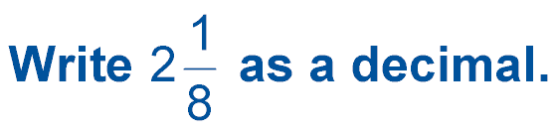
5-Minute Check 2
A. 2.8
B. 2.08
C. 2.125
D. 0.125

Slide 5

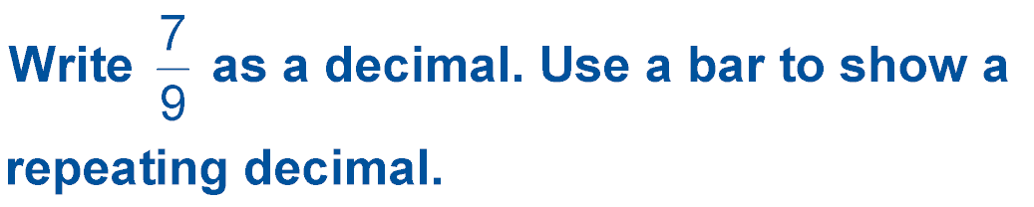
5-Minute Check 3
–
A. 0.7
B. 0.79
C. 1.285
D. 7.9
–

Slide 6

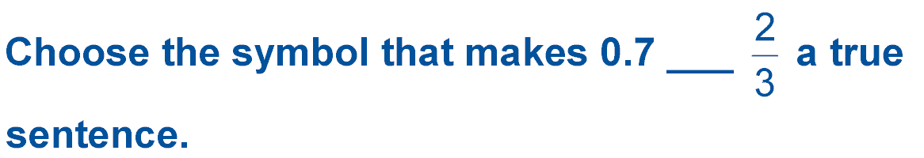
5-Minute Check 4
A. =
B. <
C. >

Slide 7

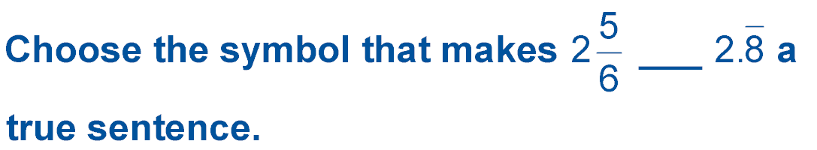
Enter question text...
A. >
B. <
C. =

Slide 8

5-Minute Check 6
Nancy made 16 of 27 free-throws last basketball season. What is Nancy’s free-throw rate to the nearest thousandth?
A. 0.16
B. 0.59
C. 0.593
D. 0.60

Slide 9


Then/Now
You have already studied natural numbers, whole numbers, and integers. (Lesson 2–1)
Write rational numbers as fractions.
Identify and classify rational numbers.

Slide 10

Vocabulary
rational numbers

Slide 11

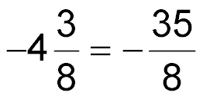
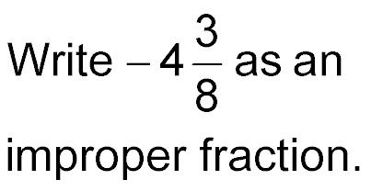
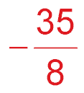
Example 1
Write Mixed Numbers and Integers as Fractions
Answer:

Slide 12

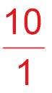
Example 1
Write Mixed Numbers and Integers as Fractions
Answer:

Slide 13




Example 1
A.
A.
B.
C.
D.

Slide 14

Example 1
B. Write –6 as a fraction.
A.
B.
C.
D.

Slide 15
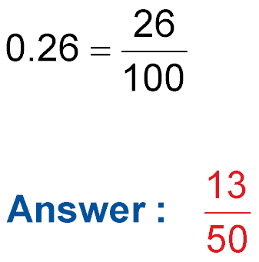
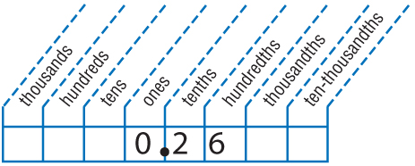
Example 2
Write Terminating Decimals
as Fractions
A. Write 0.26 as a fraction in simplest form.
0.26 is 26 hundredths.
Answer: Simplify. The GCF of 26 and 100 is 2.

Slide 16
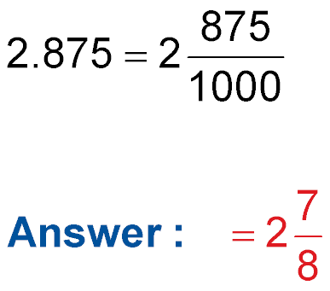
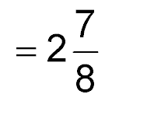
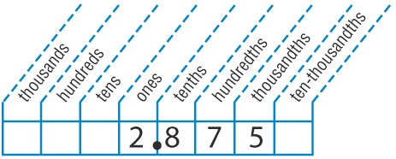
Example 2
Write Terminating Decimals
as Fractions
B. SHIPPING The shipping weight of a package is 2.875 pounds. Write this decimal as a mixed number in simplest form.
0.875 is 875 thousandths.
The GCF of 875 and 1000 is 125.
Answer:

Slide 17
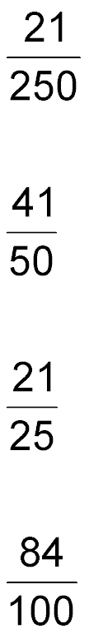
Example 2
A. Write 0.84 as a fraction in simplest form.
A.
B.
C.
D.

Slide 18
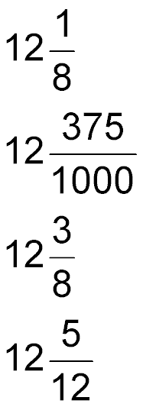
Example 2
B. RUNNING Mary runs the hundred meter dash in 12.375 seconds. Write this decimal as a mixed number in simplest form.
A.
B.
C.
D.

Slide 19
Example 3
Write Repeating Decimals as Fractions
Write 0.39 as a fraction in simplest form.
N = 0.3939. . . Let N represent the number.
100N = 100(0.3939. . .) Multiply each side by 100 because two digits repeat.
100N = 39.39
Subtract N from 100N to eliminate the repeating part, 0.3939. . . .

Slide 20
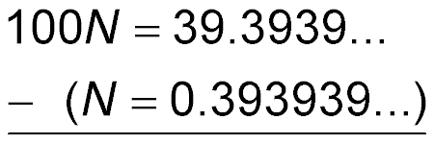

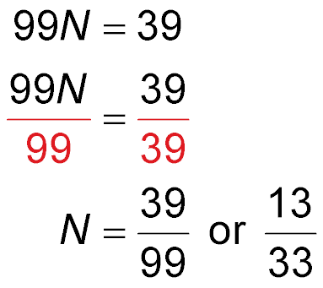
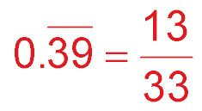
Example 3
Write Repeating Decimals as Fractions
100N – N = 100N – 1N or 99N
Divide each side by 99.
Simplify.
Answer:
÷
ENTER
Check 13 33 0.393939394
✓

Slide 21

Example 3
A.
B.
C.
D.

Slide 22
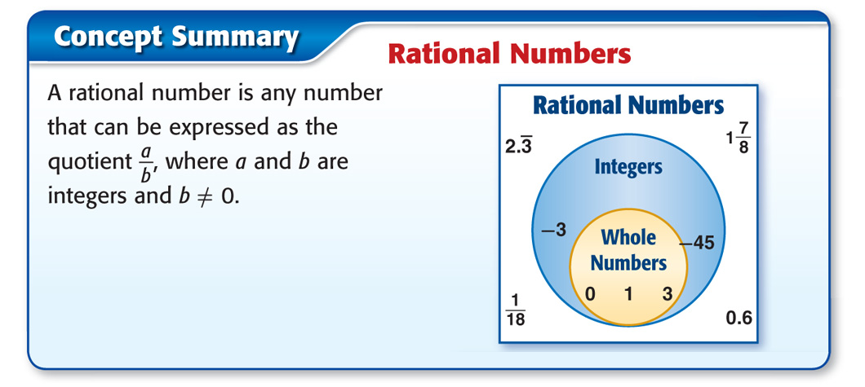
Concept

Slide 23


Example 4
Classify Numbers
A.
Answer: .

Slide 24
Example 4
Classify Numbers
B. Identify all sets to which the number 1.414213562… belongs.
1.1414213562... This is a nonterminating and nonrepeating decimal.
Answer: So, it is irrational.

Slide 25
Example 4
Classify Numbers
C. Identify all sets to which the number 15 belongs.
Answer: 15 is a whole number, an integer, and a rational number.

Slide 26

Example 4
A.
A. whole number, rational
B. integer, rational
C. not rational
D. rational

Slide 27
Example 4
B. Identify all sets to which 2.7182182845... belongs.
A. integer, rational
B. whole number, integer
C. rational
D. irrational

Slide 28
Example 4
C. Identify all sets to which –12 belongs.
A. whole number, rational
B. whole number, integer, rational
C. integer, rational
D. rational

Slide 29
End of the Lesson

